Slide 1
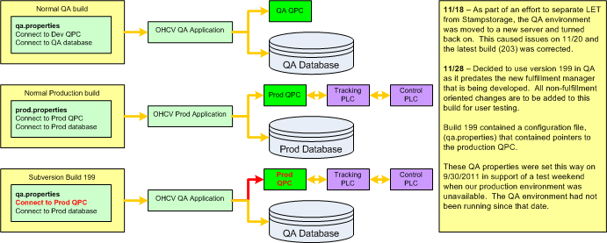
Dept
MAP Stamping
IR #
OHCV QA issue
Rev. 1 8/09 JS/DC
Phase 1
X
Completed By:
Adam Kendell Incident Date: 11/28/2011
Phase 2
Problem:
Stamping called over the radio to report an issue with carriers being re-routed to incorrect rows.
Background: We knew that QA instance had been started up and that QA instance was pointed at the production PLC/QPC module and caused issues on 11/18.
Place in this area a drawing / sketch of the problem area. Add details so the reader can understand what is supposed to happen, verses what actually happened. ( Be sure and add a timeline on another page. )
Root Cause: While the latest builds had the correct QPC configuration, the build on QA did not. No process existed to verify configuration before deployment.
Management Viewpoint:
Knew this was isolated to the Stampstorage application.
Detailed Impact For 90 minutes, carriers could have been re-routed to inappropriate rows. To fix this either a manually move the carrier or to reset the destination and reprocess. Unfortunately, there was confusion and carriers already in rows were modified that caused row inventories to be off.
Line #
N/A
Shift
B
Plant:
MAP
Counter Measure Category | Countermeasure Description | Schedule (when is the task scheduled to be completed or was completed) | Who (is responsible for the fix? Team or person)
Quick Fix |  | Completed 11/28/2011 12:48 PM | Adam Kendell / Mayank Deopa
TCM: |  | Re-Deploy Completed 11/29/2011 11:45 AM Edits Completed 11/29/2011 8:00 AM | Adam Kendell / Chuck Correll
PCM: |  | Process: 12/1/2011 Firewall : TBD | Process: Adam Kendell Firewall: Mark Jeffers
Identified Themes
Shut down the QA application instance.
Edited the QA build configuration file and re-deployed.
Edited the configuration file for every build since our go-live date to significantly reduce the likelihood of a reoccurrence.
Implement verification process to ensure the proper configuration before deploying any build.
The Stamping firewall will prevent the QA instance from connecting to the production QPC at all.

Slide 2
